Slide 1
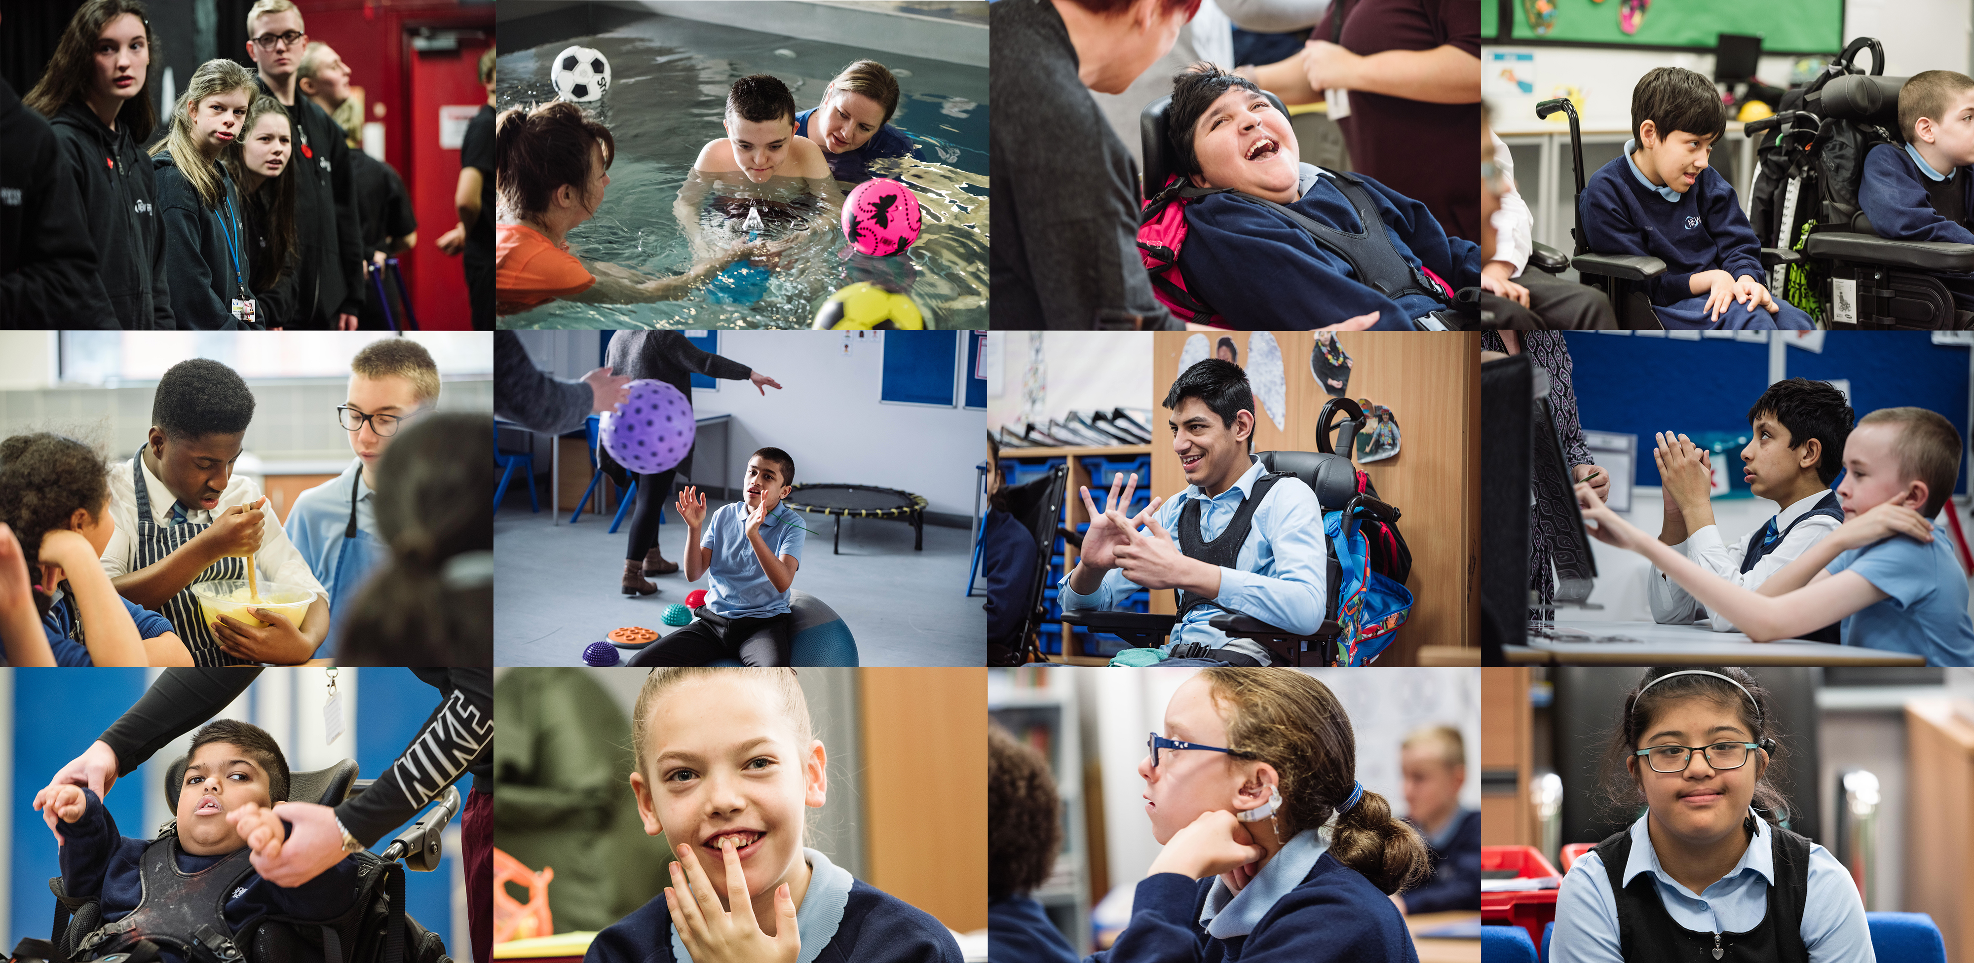


Seeing the Need Behind the Behaviour
De-escalation and Safe Responses
01/09/2026

Slide 2

Training Objectives
Today we will:
Use restrictive interventions appropriately by understanding current guidance, legal considerations, and best practice.
See beyond the behaviour by exploring what pupils may be communicating through their actions.
Respond safely and effectively using de-escalation and positive behaviour support strategies.

Slide 3

Restrictive Interventions, Including Use of Reasonable Force and Seclusion Policy
DfE statutory guidance effective April 2026
1. Why this policy is changing
New DfE statutory guidance (April 2026) introduces:
  A legal duty to record and report the use of reasonable force
  A new legal duty to record and report seclusion
Increased external scrutiny around safeguarding, SEND, proportionality and transparency
Trust requirement for consistent, sound practice across all schools
2. Definitions
Restrictive interventions – umbrella term (physical and non‑physical)
Reasonable force – proportionate physical contact to prevent harm or disorder
Restraint – restricting movement (with or without physical contact)
Seclusion – confining a pupil and preventing them from leaving even without physical barriers
3. Training
Appropriate, high‑quality training (e.g. Team Teach) for staff who may need to use restrictive interventions
Training is context‑specific and refreshed
4. SEND-focused expectations
Increased likelihood of restrictive intervention must trigger:
  Risk assessments
  Behaviour support plans
  Reasonable adjustments (Equality Act duty)
Active involvement of pupils, parents/carers and relevant professionals

Slide 4

Restrictive Interventions, Including Use of Reasonable Force and Seclusion Policy
DfE statutory guidance effective April 2026
5. Recording & reporting
Recording (CPOMS – same day)
All significant force, restraint and seclusion incidents
Clear, factual, non‑judgemental
Explains:
  What happened and why
  What de‑escalation was attempted
  Why intervention was necessary
  Any injuries and follow‑up support
Reporting to parents/carers
Same day notification
Usually verbal, followed by written record
Transparent and professional
Limited exceptions only where reporting would place the pupil at risk
6. Culture and staff protection
Force is never used as punishment
Certain practices are explicitly prohibited (e.g. airway restriction, ground restraint)
Debrief, reflection and emotional support are expected after incidents (PIL)
This policy protects staff when they act lawfully, proportionately and transparently.

Slide 5
Staff Checklist
Use restrictive interventions only as a last resort.
Follow the same legal powers as before as these have not changed.
Prioritise prevention, strong relationships, and de-escalation strategies.
Use force only when it is necessary to keep people safe.
Ensure any use of force is necessary, proportionate, and time-limited.
Never use force or seclusion as a punishment.
Use seclusion only as a safety measure, where appropriate.
Record significant incidents.
Know how and where to record incidents within your setting.
Inform parents/carers as soon as practicable following an incident.
Consider individual needs and support plans when responding to behaviour.
Complete reflection and learning activities after incidents to improve practice.
Check the guidance for key terminology.

Slide 6
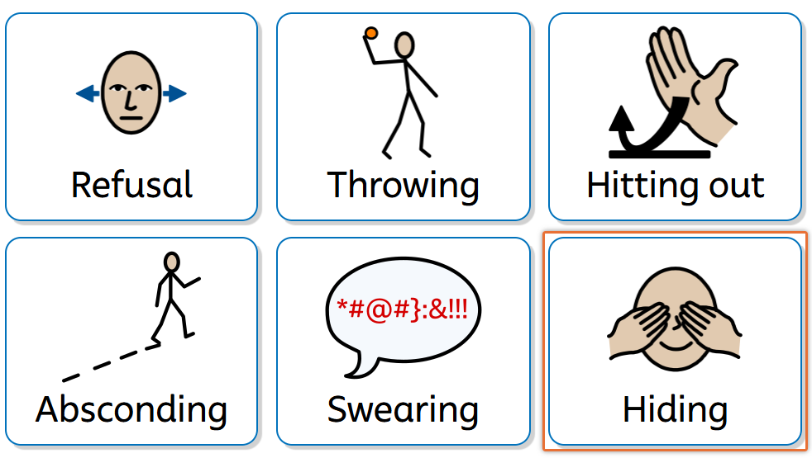

See Beyond Behaviour - Activity
Notes:
NBS Behaviour Policy states that behaviour is a response to feelings, experiences, stimuli and an individual's interpretation of events. Our job is to understand the need before we focus on the behaviour

Slide 7
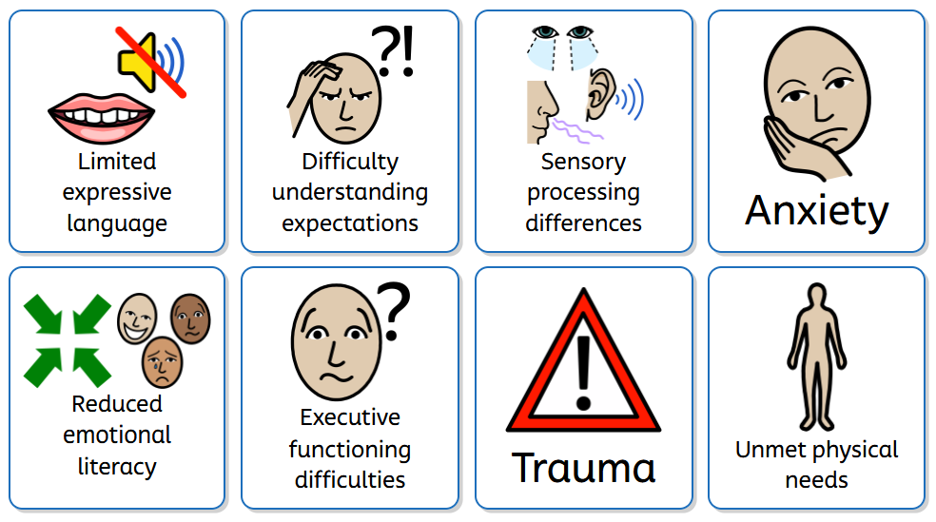
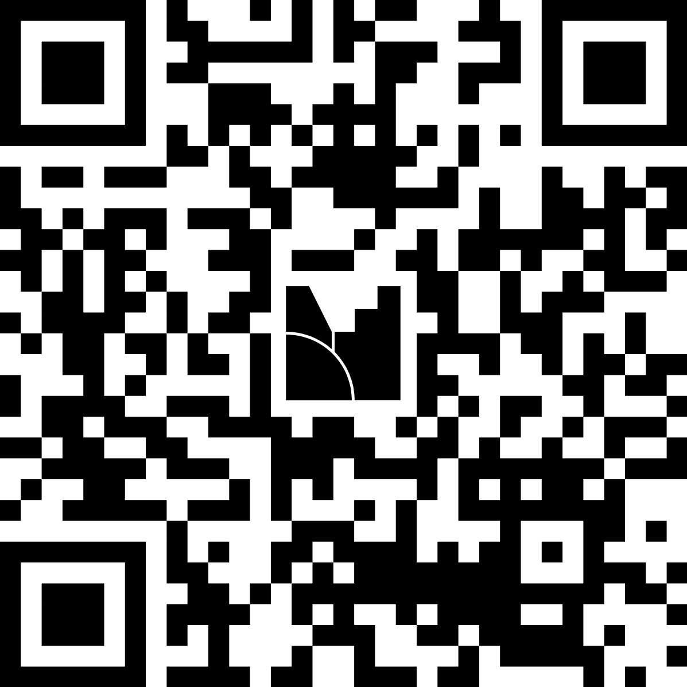
See Beyond Behaviour - Understanding
Notes:
Executive functioning difficulties are challenges with the brain's "management system" that helps us organise, plan, remember, and control our actions and emotions.
A child with executive functioning difficulties may find it hard to:
Start tasks even when they know what to do
Plan and organise their work or belongings
Remember instructions with several steps
Manage time and judge how long things will take
Switch between activities or cope with changes to routines
Control impulses and think before acting
Regulate emotions when frustrated, anxious, or overwhelmed
Stay focused and ignore distractions
It's important to remember that these difficulties are not caused by laziness, defiance, or a lack of motivation. The child may need additional support, structure, visual prompts, and adult guidance to help them succeed.
Activity Examples:
Self-injury
Repetitive behaviours
Withdrawal
Increased vocalisations
Property damage
Aggression
Key Message - For many pupils: "If they could tell us what they needed, they probably would.“ Behaviour is often the most effective communication tool they currently have.

Slide 8
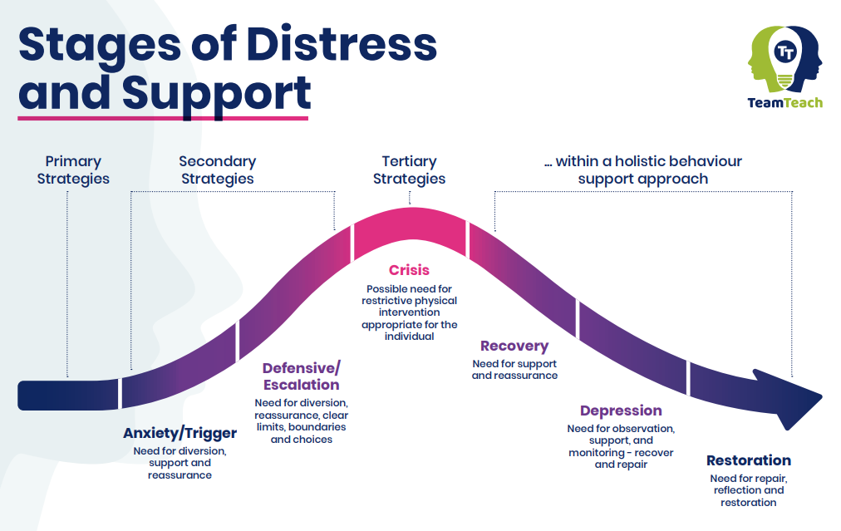
The NBS Behaviour Policy emphasises understanding individual needs, using consistent de-escalation approaches and providing time, space and reasonable adjustments to support regulation
Notes:
The Escalation Cycle
1. Regulated / Ready to Learn
The pupil feels safe, connected and able to engage.
What we might see:
Participating in learning
Communicating effectively
Following routines
Positive interactions
Engaging with adults and peers
Adult role:
Build relationships
Use praise and encouragement
Maintain predictable routines
Provide opportunities for success
Question: What helps this pupil stay regulated? In the Green Zone.
2. Trigger
Something creates discomfort, anxiety or uncertainty.
This might include:
An unexpected change
A difficult task
Noise levels
Waiting
Transition between activities
Not understanding instructions
Communication breakdown
Sensory overload
Conflict with peers
What we might see:
Stopping work
Increased questioning
Seeking reassurance
Avoidance
Fidgeting
Repetitive behaviours
Adult response:
Notice the trigger
Reduce demands if needed
Clarify expectations
Offer reassurance
Provide visual support
3. Anxiety / Distress
This is often the most important stage.
The pupil's nervous system is beginning to move into a stress response.
What we might see:
Pacing
Refusing work
Increased vocalisations
Swearing
Rocking
Covering ears
Repetitive questioning
Walking away
Arguing
Increased stimming
Clinging to adults
Remember:
These behaviours are often communication, not deliberate defiance.
The pupil may be communicating:
"This is too hard."
"I don't understand."
"This feels unsafe."
"I need a break."
"I'm overwhelmed."
Adult response:
Lower your voice
Use fewer words
Give processing time
Reduce demands
Offer choices
Support regulation
Increase physical space
Use known calming strategies
4. Escalation
At this point the pupil's thinking brain is becoming less available.
Behaviour becomes more visible and more challenging.
What we might see:
Shouting
Throwing objects
Refusal
Running away
Threatening language
Property damage
Aggression
Common adult trap: Trying to reason, lecture or negotiate.
Instead:
Prioritise safety
Stay calm
Keep language short
Avoid power struggles
Remove the audience where possible
Call for support early
Helpful script:
"I can see this is difficult."
"I'm here to help."
"Let's move somewhere quieter."
5. Crisis
The pupil has lost the ability to self-regulate.
This is not usually a learning moment.
Their primary focus is survival, not compliance.
What we might see:
Significant aggression
Serious property damage
Complete refusal
High levels of distress
Risk of harm
Adult response:
Keep everyone safe
Reduce verbal interaction
Follow behaviour plans, PSPs and risk assessments
Use Team Teach approaches where necessary
Restrictive intervention only if reasonable, proportionate and necessary to prevent harm.
6. Recovery
The behaviour may stop before the distress has reduced.
Many pupils feel:
Exhausted
Ashamed
Confused
Vulnerable
Adult response:
Allow recovery time
Rebuild connection
Avoid lengthy discussions immediately
Support regulation
Restore dignity
Only problem-solve when calm.
Question: At what point do we have the greatest influence?
Answer: Many adults intervene most heavily at the escalation stage, when actually our greatest influence is during the trigger and anxiety stages.
Most behaviours that challenge do not appear suddenly. Pupils often show early signs that they are becoming overwhelmed, anxious, confused or dysregulated. The earlier we notice these signs, the more likely we are to successfully de-escalate and avoid crisis. Behaviour is communication. Regulation comes before reasoning. Connection comes before correction. The earlier we respond, the less likely we are to need restrictive interventions.

Slide 9
Effective De-escalation: The Adult is the Intervention
"Having all staff practice a consistent, de-escalating approach to behaviours that are conducive to 'Be Safe, Be Respectful and Be Ready to Learn', with shared language.“
DO | AVOID
Stay calm | Arguing
Use a quiet voice | Threats
Use fewer words | Repeated demands
Give processing time | Power struggles
Offer choices | Crowding the pupil
Acknowledge feelings | Asking “Why?” during crisis
Increase personal space
Support Regulation
Connection before correction. Regulation before reasoning. The earlier we respond, the less likely behaviour will escalate.
Notes:
De-escalation is not something we do to pupils. It is something we do with pupils.
One of the most important messages from the Behaviour Policy is that staff should use a consistent de-escalating approach and provide pupils with the time, space and reasonable adjustments they need to return to a place of safety and regulation.
When a pupil becomes distressed, our role shifts from teaching and correcting to supporting regulation. The goal is not to 'win' an argument or gain compliance. The goal is to reduce anxiety and keep everyone safe.
When a pupil is becoming overwhelmed, their ability to think logically reduces. This is especially important for our pupils with communication needs and autism, who may already be working very hard to process information.
If we increase demands, use lots of language, or challenge behaviours at this point, we can unintentionally increase their distress.
The calmer the adult, the calmer the environment. (The adult = regulator)
Reflection: Think of a pupil you know well. What is usually the first sign that they are becoming dysregulated?
Question: Which de-escalation strategy tends to work best for them?
Reinforce: personalisation – link to policy’s emphasis on understanding individual needs and personalised approaches.
REMEMBER: A dysregulated child is not giving you a hard time. They're having a hard time. Your behaviour policy emphasises understanding needs, nurturing relationships, providing support for regulation and using de-escalation approaches consistently across school. The most effective intervention is often not what we do in crisis, but what we do in the minutes before crisis occurs

Slide 10
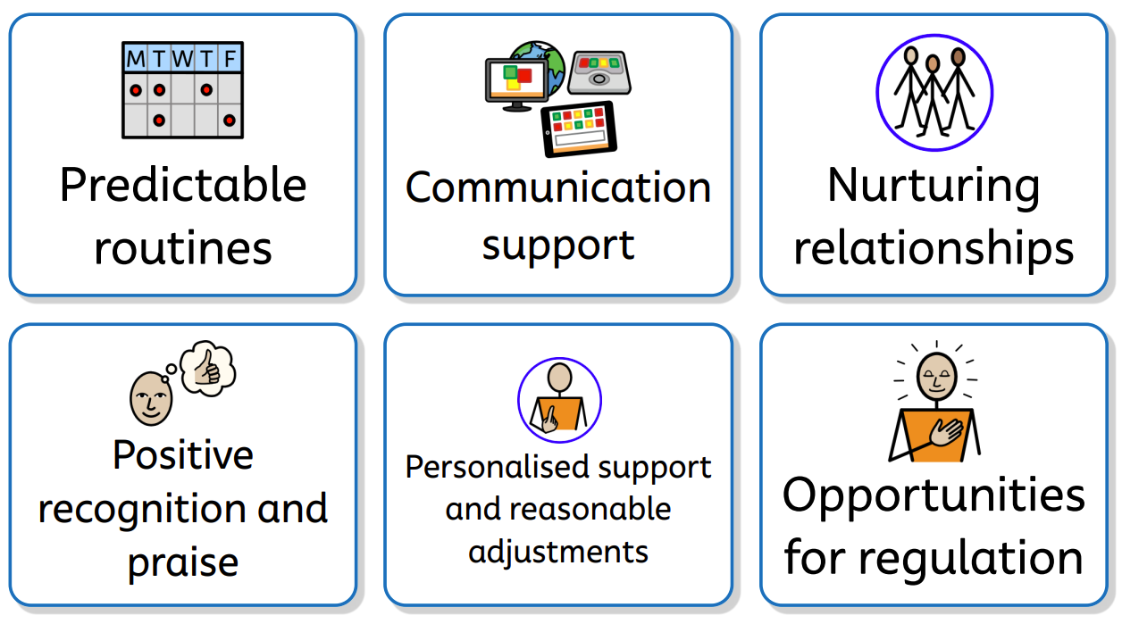
Respond Safely and Effectively: Positive Behaviour Strategies
Understanding the needs of every learner is at the heart of everything we do. Nurturing, respectful relationships form the foundation of positive behaviour. Positive praise and rewards are more effective than consequences in motivating pupils.
Notes:
After thinking about escalation and de-escalation, it's important to remember that the most effective intervention is often prevention.
When we hear the term 'behaviour support', many people think about what happens during a crisis. However, the policy makes it clear that our approach is built on understanding needs, nurturing relationships and creating the conditions for pupils to succeed.
Positive behaviour support asks us to move from "How do I stop this behaviour?“ to "What does this pupil need to be successful?“
The policy states:
'Behaviour is a form of communication in response to a feeling, experience, or stimulus.'
If we believe behaviour is communication, then our response must go beyond consequences. We need to understand why the behaviour is happening.
Quote 2: Research and experience consistently tell us that pupils are more likely to engage, regulate and recover when they feel safe with the adults around them.
For many pupils with SLD, communication difficulties or previous negative experiences of education, relationships are often the intervention.
Practical examples:
Greeting pupils positively
Knowing their interests
Using preferred communication methods
Showing genuine curiosity
Repairing relationships after incidents
Ask: Think of a pupil you support well. What have you done to build that relationship?
Look at visual.
Fair isn't everyone getting the same.
Fair is everyone getting what they need.
Example:
Pupil throws work/iPad on floor.
Some may assume: pupils is being difficult, refusal, attention seeking (intro: attention needing).
What’s actually happening could be: task too difficult, lack of understanding, sensory overload, anxiety, fear of failure, communication frustration
Positive behaviour support is about becoming behaviour detectives rather than behaviour judges.
De-escalation is important, but the most powerful behaviour strategy is creating an environment where escalation is less likely to happen in the first place

Slide 11
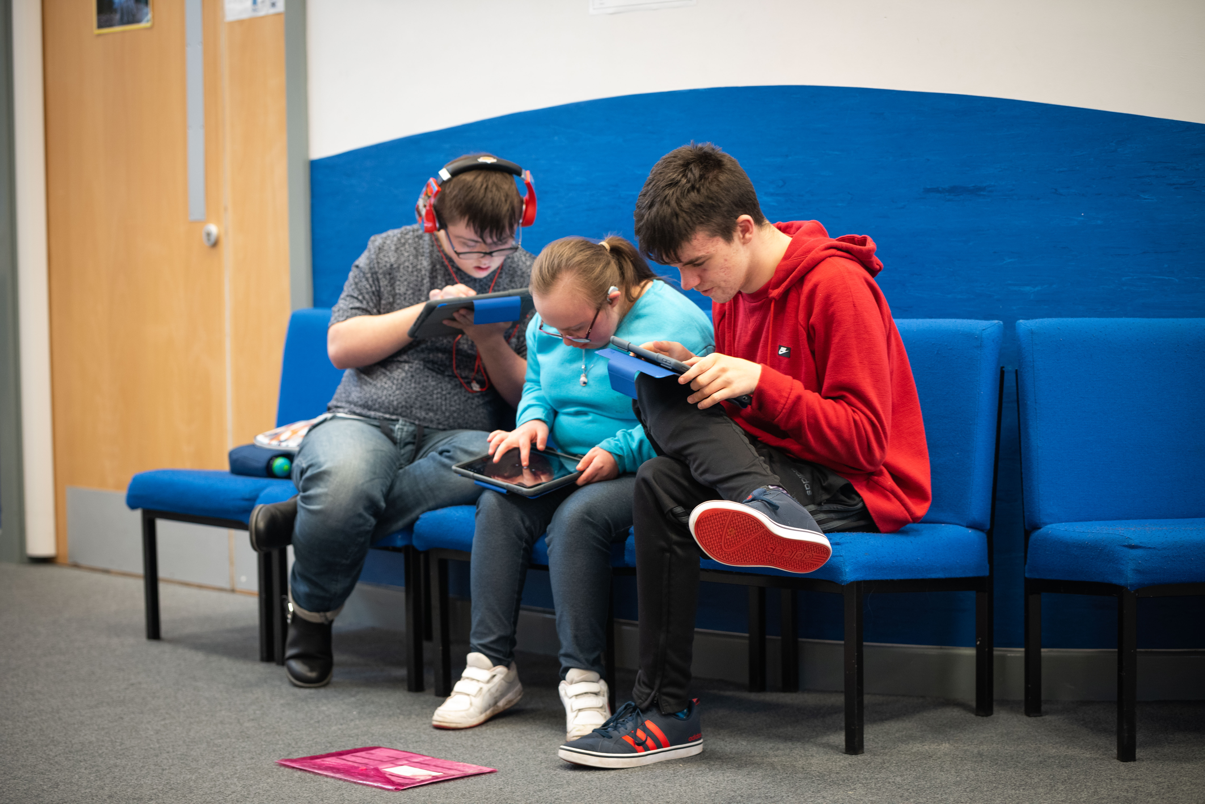
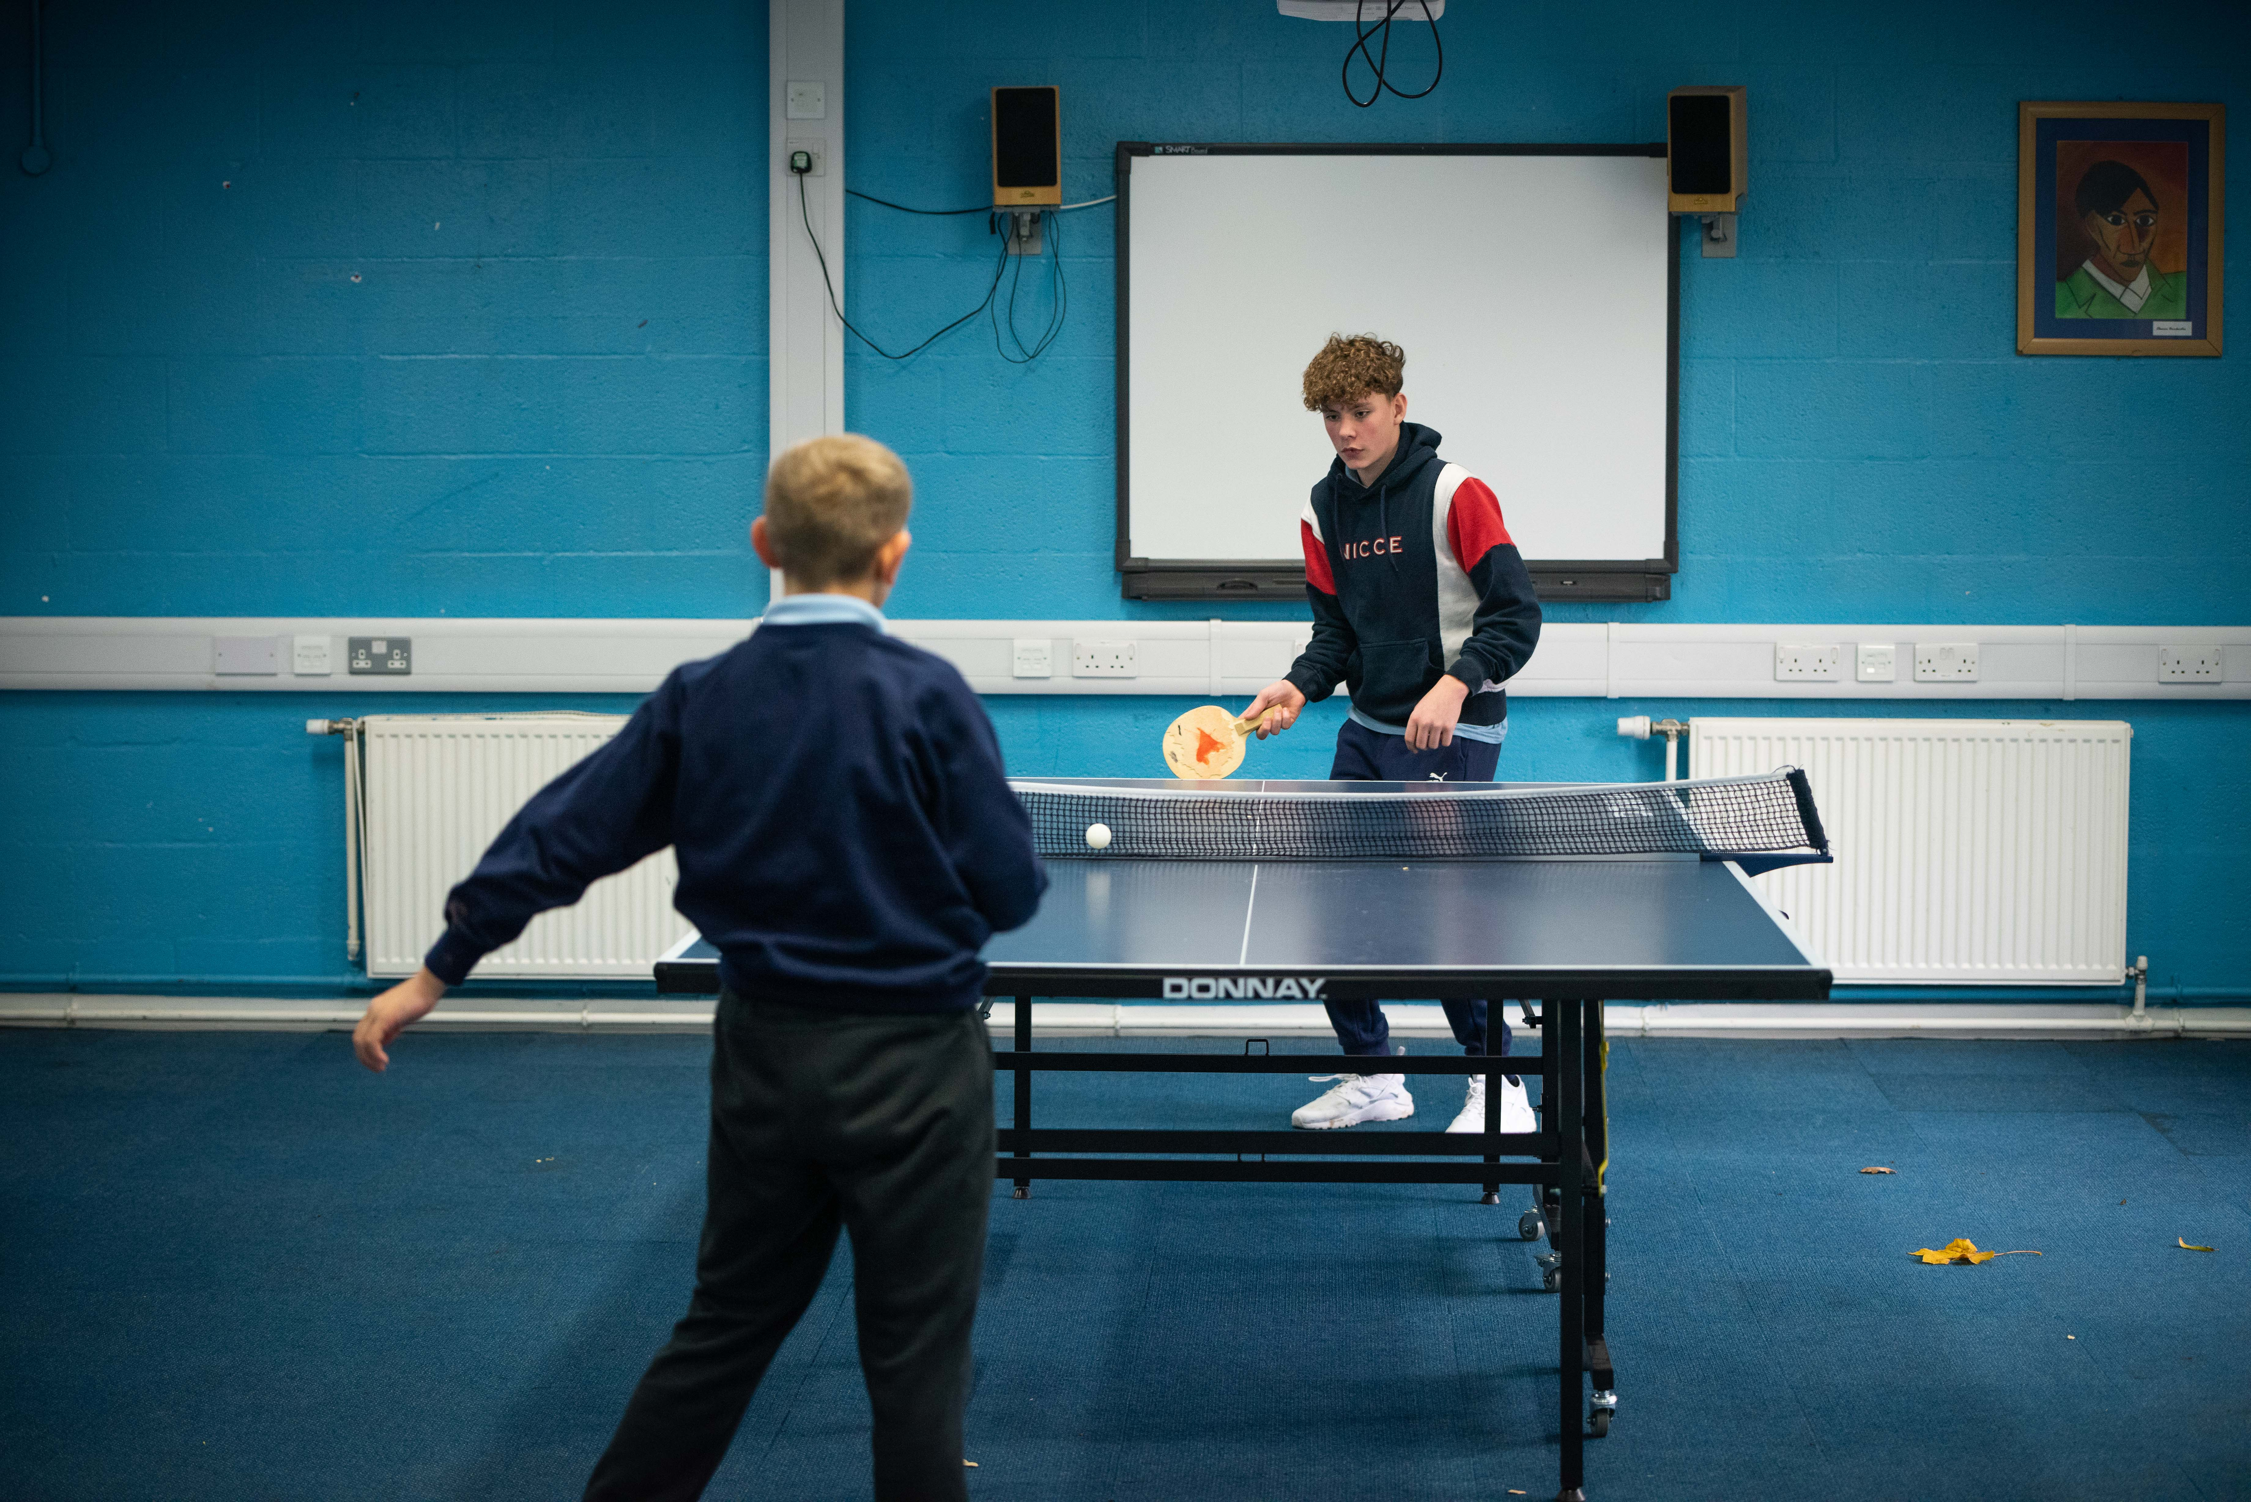
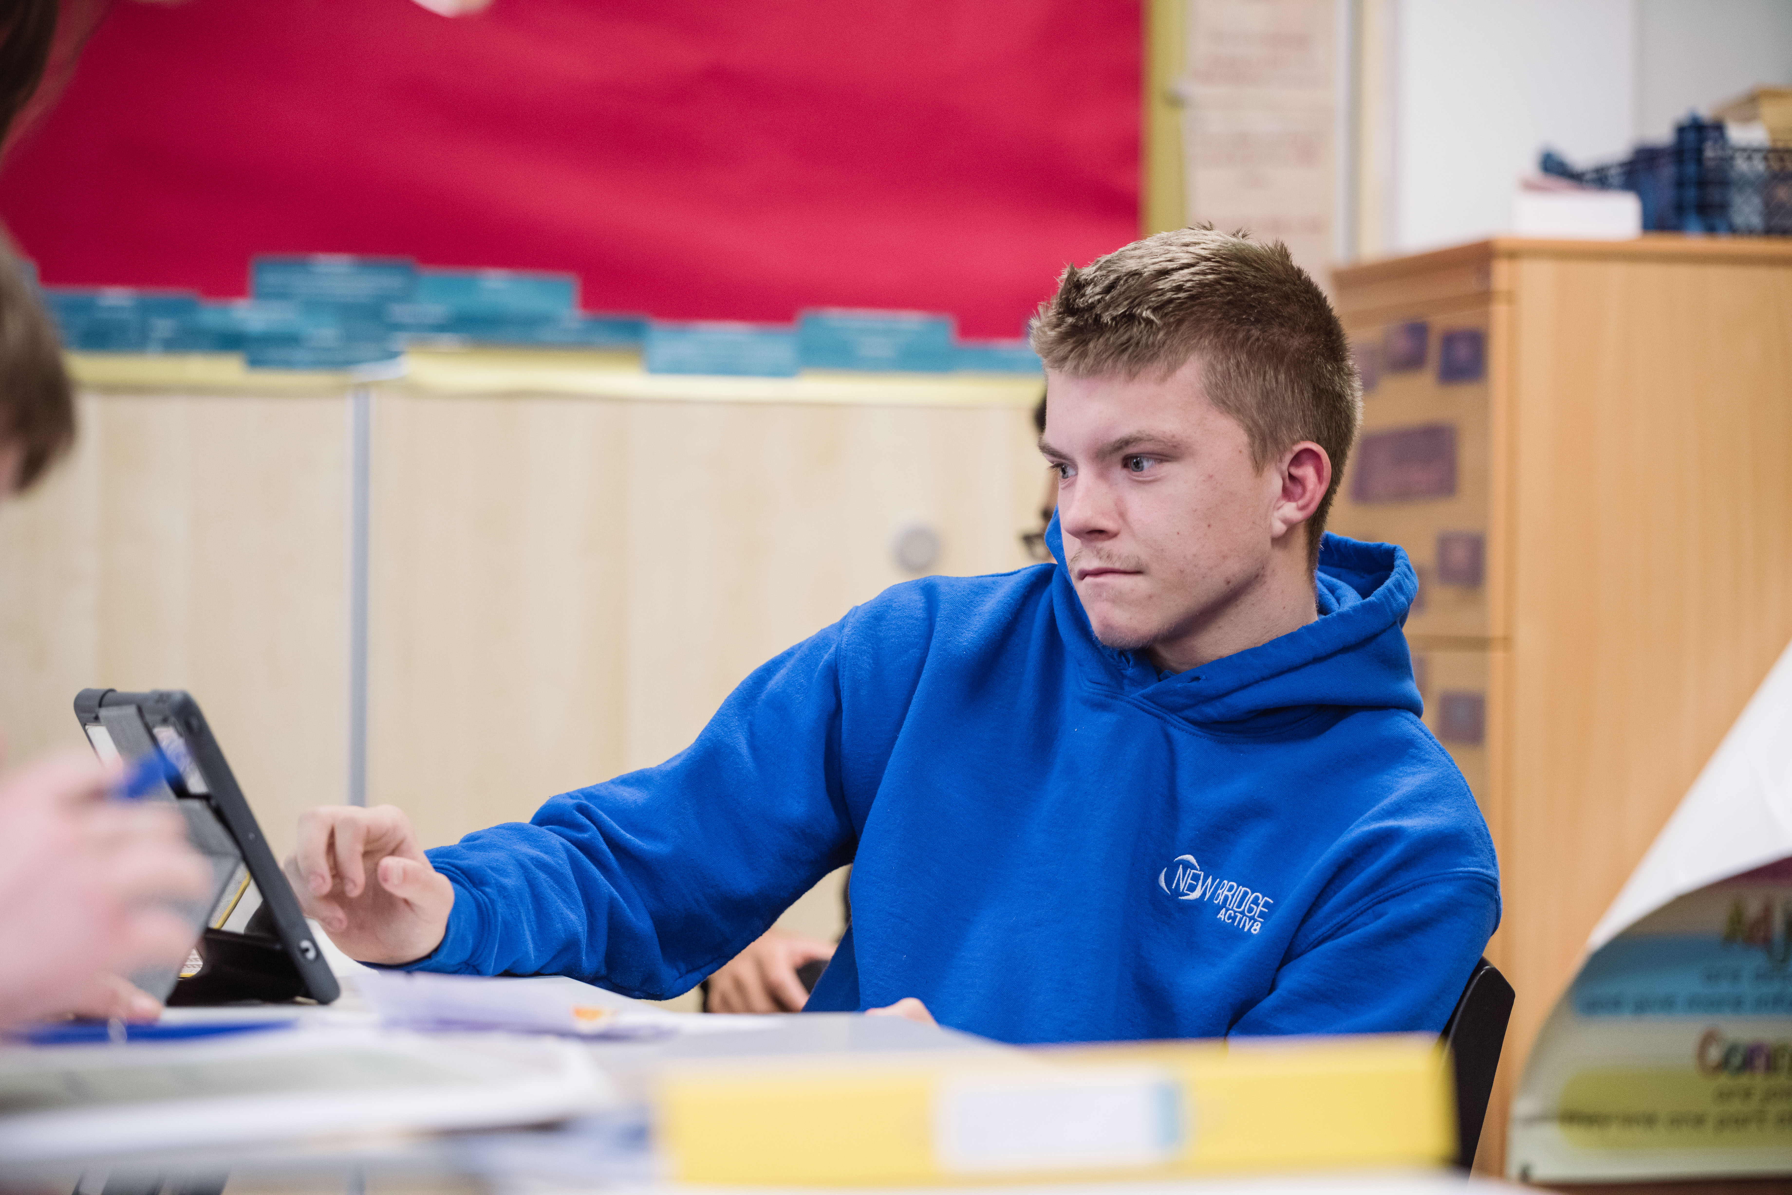
Key Takeaways
P
Behaviour is communication.
Connection comes before correction.
Regulation comes before reasoning.
De-escalation is everyone's responsibility.
Restrictive intervention is a last resort.

Slide 12
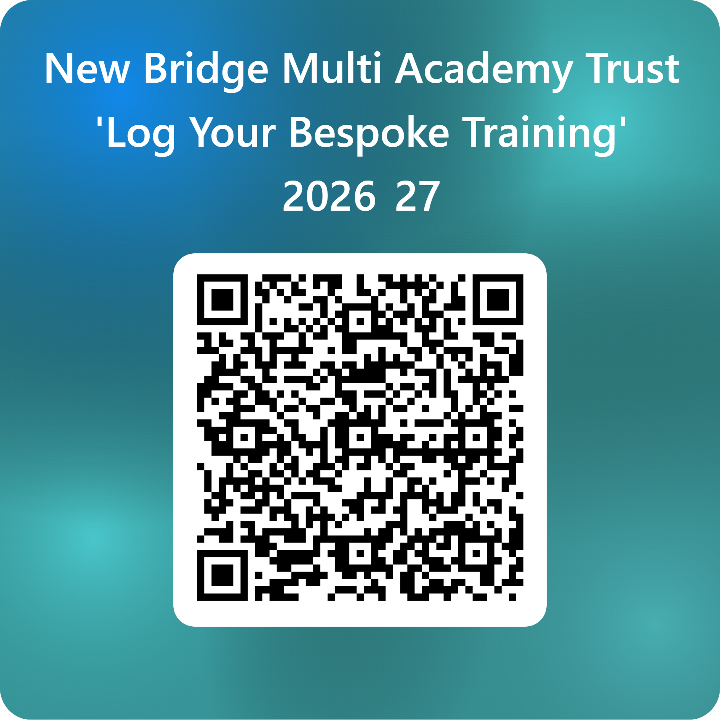
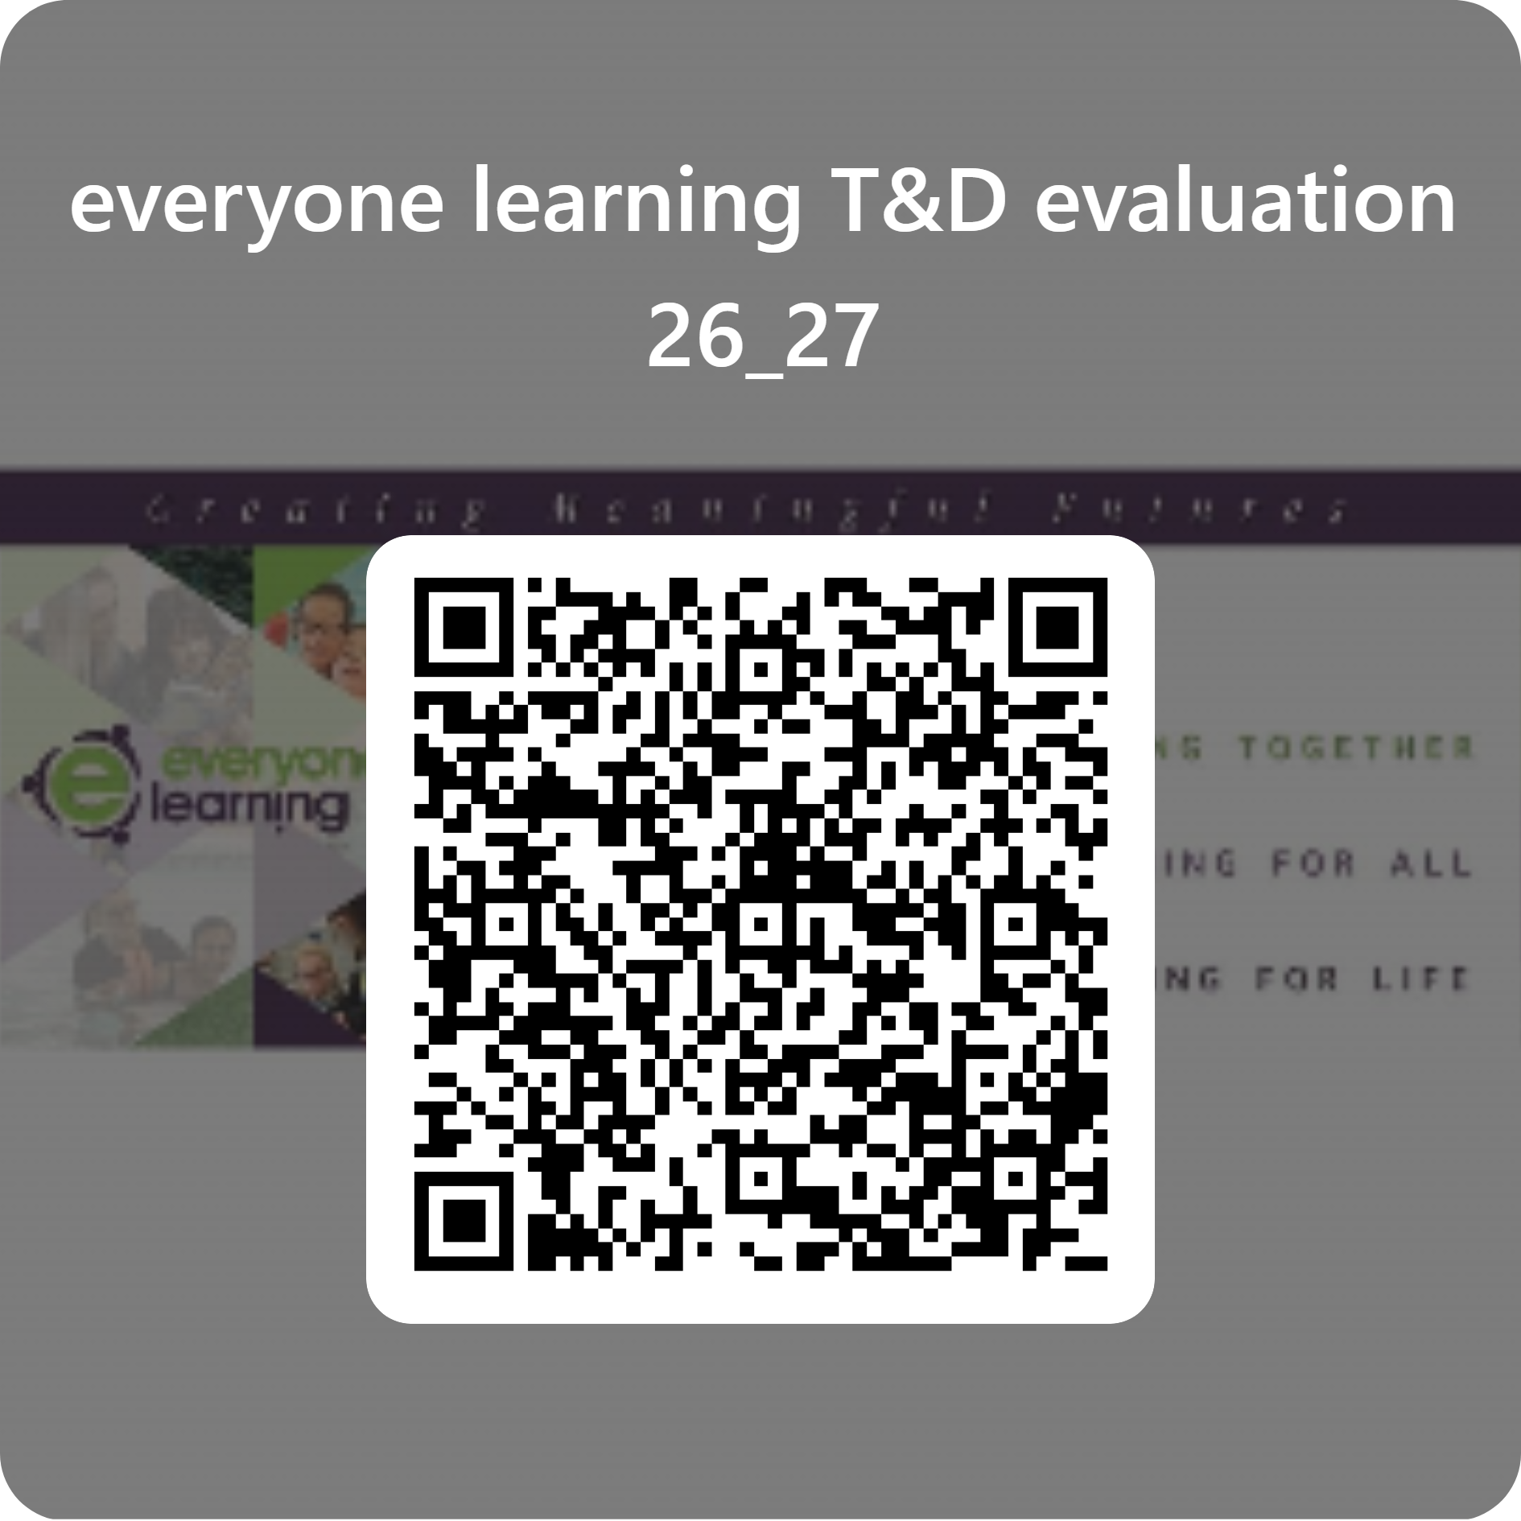

Slide 13

Contact me:
Katie.cash@newbridgegroup.org
07384460099
Executive Advisor
Safeguarding and Behaviour

